Slide 1



Objects & Arrays
Working with complex data types
29 SEPTEMBER | XOLA DOS SANTOS

Slide 2

“
Think twice, code once.
Xola dos Santos

Slide 3

RECAP
What we covered last week
Types of conditionals
Logical operators

Slide 4
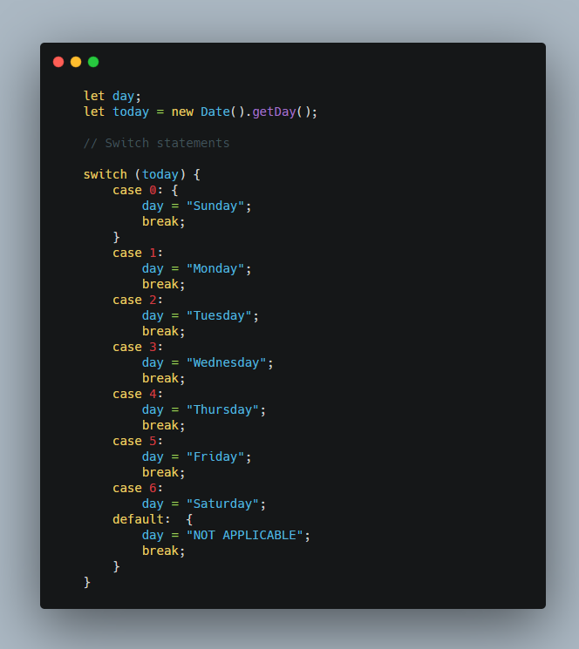
Conditional Operators:
- is equal to ==
- is not equal to !=
- is (strict) equal to === ( checks data type and value )
- is (strict) not equal to !==
- is greater than >
- is less than sign <
Logical Operators:
- Logical AND : &&
- Logical OR : ||
- Logical NOT : !
Switch Statements

Slide 5


Slide 6

Objects & Arrays
Arrays Intro
Data Types
Objects Intro
Array Methods & Properties
Arrays in Dept

Slide 7


Slide 8

Challenges
Exercises for next week
Frontend Validation Challenges 1-3

Slide 9


Slide 10

CONTACT
www.codespace.co.za
@codespace_academy
emma@codespace.co.za

